Slide 1

CoderDojo
Scratch Beginners
Code and notes by permission Michael Madden, 2012

Slide 2
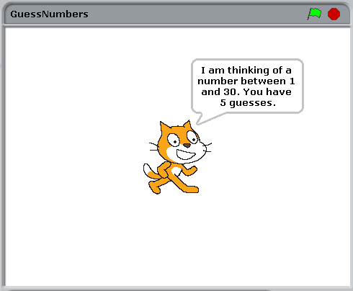
Today's Ninja Challenge: Write a Number Guessing Game!

Slide 3
Today's Big Ideas
Input & Output
Decisions &
Comparing
Variables
Also: loops & decisions

Slide 4
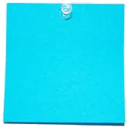
How to Get Started
Plan the Design
Create First Character
Think first!
Design it: appearance & behaviours
Test It
Any bugs? (Not working as expected)
Extend It
More Characters, More Behaviours, More Testing!
Start simple: add more later
Write script (Code) to control its behaviours
Debug and Improve
Reminder from last time

Slide 5
How to Make Progress
Our Creative Coding Rule: There's More Than One Way to Do It!
Try things out and iterate
Save copies: go back if it doesn't work
Talk to others, share ideas, learn from their ideas, improve on their ideas!
Examine other people's code on the Scratch website & upload your code
Reminder from last time

Slide 6
What We Need To Figure Out
Pick a random number and store it
Test if it's right:
Display "Correct!" if it is
Test if it's too high or too low;
Display messages
Give them 5 guesses
Ask the player to guess it and store their answer

Slide 7
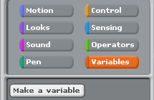
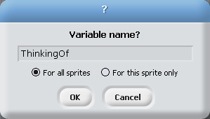

Create a Variable to Hold a Random Number
Tip: Clear this checkbox so it is not shown on screen

Slide 8

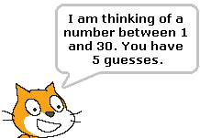
When Flag is Clicked: Pick Random Number, Display "I am thinking of …"

Slide 9
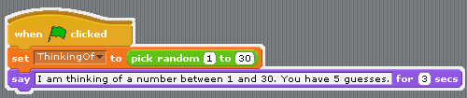
When Flag is Clicked: Pick Random Number, Display "I am thinking of …"

Slide 10
Ask Player to Guess It, Store Answer

Slide 11

Ask Player to Guess It, Store Answer
Need another variable!
I've called it Guess.

Slide 12
Test whether Guess is Right, Too High, Too Low

Slide 13
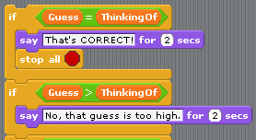
Test Whether Guess is Right, Too High, Too Low
You need to complete this …

Slide 14
Give Player Five Guesses

Slide 15
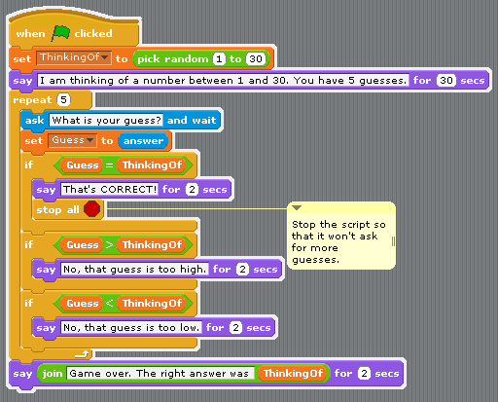
Give Player Five Guesses
Use Join to put a variable value in a message

Slide 16
More Things to Try …
Add sound effects! Hint: Go to sprite's Sound tab, import sounds Add commands to play sounds
Add a timer! Hint: Add another variable called Timer. Add another block: When flag is clicked, set it to 60 Repeat until 0: change by -1, wait a second Time up: stop all scripts.
Other ideas?

Slide 17
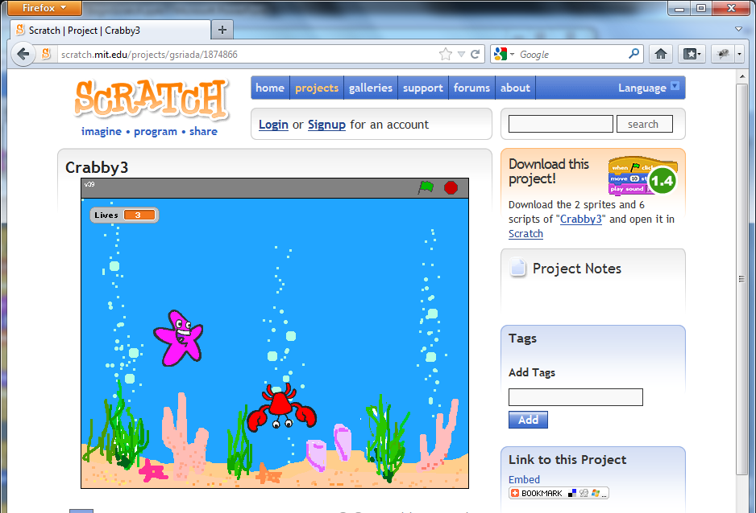
At the End …
Upload your project to the Scratch Website user: emcdojo password: cork123
Access it
from home
Improve it
Show your
friends!

